Slide 1
Topic 6 – Applications
Infrastructure Services (DNS)
Now with added security…
Traditional Applications (web)
Now with added QUIC
Multimedia Applications (SIP)
One day (more…)…
P2P Networks
Every device serves
Notes:
Applications need their own protocols.
These applications are part network protocol (in the sense that they exchange messages with their peers on other machines) and part traditional application program (in the sense that they interact with the windowing system, the file system, and ultimately, the user).
This topic explores some of the most popular network applications available today.

Slide 2

Client-server paradigm reminder
server:
always-on host
permanent IP address
server farms for scaling
clients:
communicate with server
may be intermittently connected
may have dynamic IP addresses
do not communicate directly with each other
client/server

Slide 3
Relationship Between Names&Addresses
Addresses can change underneath
Move www.bbc.co.uk to 212.58.246.92
Humans/Apps should be unaffected
Name could map to multiple IP addresses
www.bbc.co.uk to multiple replicas of the Web site
Enables
Load-balancing
Reducing latency by picking nearby servers
Multiple names for the same address
E.g., aliases like www.bbc.co.uk and bbc.co.uk
Mnemonic stable name, and dynamic canonical name
Canonical name = actual name of host

Slide 4
Mapping from Names to Addresses
Originally: per-host file /etc/hosts*
SRI (Menlo Park) kept master copy
Downloaded regularly
Flat namespace
Single server not resilient, doesn’t scale
Adopted a distributed hierarchical system
Two intertwined hierarchies:
Infrastructure: hierarchy of DNS servers
Naming structure: www.bbc.co.uk
*C:\Windows\System32\drivers\etc\hosts for recent windows
Notes:
Could have one without the other…

Slide 5
Domain Name System (DNS)
Top of hierarchy: Root
Location hardwired into other servers
Next Level: Top-level domain (TLD) servers
.com, .edu, etc.
.uk, .au, .to, etc.
Managed professionally
Bottom Level: Authoritative DNS servers
Actually do the mapping
Can be maintained locally or by a service provider

Slide 6
Distributed Hierarchical Database
unnamed root
com
edu
org
ac
uk
zw
arpa
generic domains
country domains
bar
Top-Level Domains (TLDs)
ac
in-
addr
west
east
cam
foo
my
cl
my.east.bar.edu
cl.cam.ac.uk

Slide 7
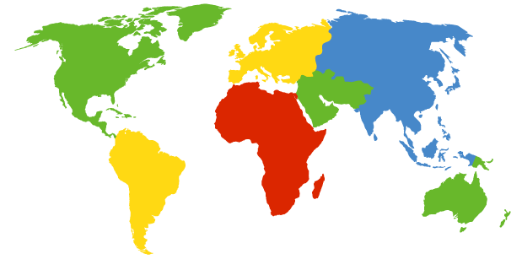
DNS Root
Located in Virginia, USA
How do we make the root scale?
Verisign, Dulles, VA

Slide 8
DNS Root Servers
13 root servers (see http://www.root-servers.org/)
Labeled A through M
Does this scale?
A Verisign, Dulles, VA
C Cogent, Herndon, VA
D U Maryland College Park, MD
G US DoD Vienna, VA
H ARL Aberdeen, MD
J Verisign
K RIPE London
I Autonomica, Stockholm
E NASA Mt View, CA
F Internet Software
Consortium
Palo Alto, CA
M WIDE Tokyo
B USC-ISI Marina del Rey, CA
L ICANN Los Angeles, CA

Slide 9
DNS Root Servers
13 root servers (see http://www.root-servers.org/)
Labeled A through M
Replication via any-casting (localized routing for addresses)
A Verisign, Dulles, VA
C Cogent, Herndon, VA (also Los Angeles, NY, Chicago)
D U Maryland College Park, MD
G US DoD Vienna, VA
H ARL Aberdeen, MD
J Verisign (21 locations)
K RIPE London (plus 16 other locations)
I Autonomica, Stockholm (plus 29 other locations)
E NASA Mt View, CA
F Internet Software
Consortium,
Palo Alto, CA
(and 37 other locations)
M WIDE Tokyo
plus Seoul, Paris, San Francisco
B USC-ISI Marina del Rey, CA
L ICANN Los Angeles, CA

Slide 10
Using DNS
Two components
Local DNS servers
Resolver software on hosts
Local DNS server (“default name server”)
Usually near the endhosts that use it
Local hosts configured with local server (e.g., /etc/resolv.conf) or learn server via DHCP
Client application
Extract server name (e.g., from the URL)
Do gethostbyname() to trigger resolver code
Notes:
6/Mar/2013

Slide 11
How Does Resolution Happen? (Iterative example)
root DNS server
Host at cl.cam.ac.uk wants IP address for www.stanford.edu
2
3
TLD DNS server
local DNS server
dns.cam.ac.uk
4
5
iterated query:
Host enquiry is delegated to local DNS server
Consider
transactions 2 – 7 only
contacted server replies with name of next server to contact
“I don’t know this name, but ask this server”
7
6
1
8
authoritative DNS server
dns.stanford.edu
requesting host
cl.cam.ac.uk
www.stanford.edu
Notes:
FIX THIS – expanded example? and better differentiation between this and recursive

Slide 12
DNS name resolution recursive example
root DNS server
recursive query:
puts burden of name resolution on contacted name server
heavy load?
2
3
7
6
TLD DNS server
local DNS server
dns.cam.ac.uk
5
4
1
8
authoritative DNS server
dns.stanford.edu
requesting host
cl.cam.ac.uk
www.stanford.edu

Slide 13
Recursive and Iterative Queries - Hybrid case
Recursive query
Ask server to get answer for you
E.g., requests 1,2 and responses 9,10
Iterative query
Ask server who to ask next
E.g., all other request-response pairs
root DNS server
3
4
TLD DNS server
5
Site DNS server
dns.cam.ac.uk
6
2
9
Site DNS server
dns.cl.cam.ac.uk
8
7
1
10
authoritative DNS server
dns.stanford.edu
requesting host
my-host.cl.cam.ac.uk
Notes:
Most common case: this mixed usage: host to local: recursive; local: iterative

Slide 14
DNS Caching
Performing all these queries takes time
And all this before actual communication takes place
E.g., 1-second latency before starting Web download
Caching can greatly reduce overhead
The top-level servers very rarely change
Popular sites (e.g., www.bbc.co.uk) visited often
Local DNS server often has the information cached
How DNS caching works
DNS servers cache responses to queries
Responses include a “time to live” (TTL) field
Server deletes cached entry after TTL expires
Notes:
2019-2-25

Slide 15
Negative Caching
Remember things that don’t work
Misspellings like bbcc.co.uk and www.bbc.com.uk
These can take a long time to fail the first time
Good to remember that they don’t work
… so the failure takes less time the next time around
But: negative caching is optional
And not widely implemented

Slide 16
Reliability
DNS servers are replicated (primary/secondary)
Name service available if at least one replica is up
Queries can be load-balanced between replicas
Usually, UDP used for queries
Need reliability: must implement this on top of UDP
Spec supports TCP too, but not always implemented
Try alternate servers on timeout
Exponential backoff when retrying same server
Same identifier for all queries
Don’t care which server responds

Slide 17
From https://www.caida.org/publications/presentations/2008/wide_castro_root_servers/wide_castro_root_servers.pdf

Slide 18
From https://www.caida.org/publications/presentations/2008/wide_castro_root_servers/wide_castro_root_servers.pdf
awm22: at least WORKGROUP is no longer here!
It was the top in valid TLD for years…

Slide 19







Data flow through the DNS
Where are the vulnerable points?
Registrars
& Registrants
Server vulnerability
Secondary
DNS
Man in the Middle
primary
DNS
spoofing
&
Man in the Middle
Registry
Secondary
DNS

Slide 20
DNS and Security
No way to verify answers
Opens up DNS to many potential attacks
DNSSEC fixes this
Most obvious vulnerability: recursive resolution
Using recursive resolution, host must trust DNS server
When at Starbucks, server is under their control
And can return whatever values it wants
More subtle attack: Cache poisoning
Those “additional” records can be anything!
Notes:
2020-3-9

Slide 21
DNSSEC protects all these end-to-end
provides message authentication and integrity verification through cryptographic signatures
You know who provided the signature
No modifications between signing and validation
It does not provide authorization
It does not provide confidentiality
It does not provide protection against DDOS

Slide 22
DNSSEC in practice
Scaling the key signing and key distribution
Solution: Using the DNS to Distribute Keys
Distributing keys through DNS hierarchy:
Use one trusted key to establish authenticity of other keys
Building chains of trust from the root down
Parents need to sign the keys of their children
Only the root key needed in ideal world
Parents always delegate security to child

Slide 23
Why is the web so successful?
What do the web, youtube, facebook, twitter, instagram, ….. have in common?
The ability to self-publish
Self-publishing that is easy, independent, free
No interest in collaborative and idealistic endeavor
People aren’t looking for Nirvana (or even Xanadu)
People also aren’t looking for technical perfection
Want to make their mark, and find something neat
Two sides of the same coin, creates synergy
“Performance” more important than dialogue….
Notes:
16-Feb-2015

Slide 24
Web Components
Infrastructure:
Clients
Servers
Proxies
Content:
Individual objects (files, etc.)
Web sites (coherent collection of objects)
Implementation
HTML: formatting content
URL: naming content
HTTP: protocol for exchanging content
Any content not just HTML!

Slide 25
HTML: HyperText Markup Language
A Web page has:
Base HTML file
Referenced objects (e.g., images)
HTML has several functions:
Format text
Reference images
Embed hyperlinks (HREF)
Notes:
Each object is uniquely identified. How?

Slide 26
URL Syntax
protocol://hostname[:port]/directorypath/resource
protocol | http, ftp, https, smtp, rtsp, etc.
hostname | DNS name, IP address
port | Defaults to protocol’s standard port e.g. http: 80 https: 443
directory path | Hierarchical, reflecting file system
resource | Identifies the desired resource Can also extend to program executions: http://us.f413.mail.yahoo.com/ym/ShowLetter?box=%40B%40Bulk&MsgId=2604_1744106_29699_1123_1261_0_28917_3552_1289957100&Search=&Nhead=f&YY=31454&order=down&sort=date&pos=0&view=a&head=b

Slide 27
HyperText Transfer Protocol (HTTP)
Request-response protocol
Reliance on a global namespace
Resource metadata
Stateless
ASCII format (ok this changed….)
$ telnet www.cl.cam.ac.uk 80
GET /win HTTP/1.0
<blank line, i.e., CRLF>

Slide 28
Steps in HTTP Request
HTTP Client initiates TCP connection to server
SYN
SYNACK
ACK
Client sends HTTP request to server
Can be piggybacked on TCP’s ACK
HTTP Server responds to request
Client receives the request, terminates connection
TCP connection termination exchange
How many RTTs for a single request?
Notes:
Know this
Draw!!!

Slide 29
Client-Server Communication
two types of HTTP messages: request, response
HTTP request message: (GET POST HEAD ….)
request line
(GET, POST,
HEAD commands)
GET /somedir/page.html HTTP/1.1
Host: www.someschool.edu
User-agent: Mozilla/4.0
Connection: close
Accept-language:fr
(extra carriage return, line feed)
HTTP response message
header
lines
status line
(protocol
status code
status phrase)
HTTP/1.1 200 OK
Connection close
Date: Thu, 06 Aug 1998 12:00:15 GMT
Server: Apache/1.3.0 (Unix)
Last-Modified: Mon, 22 Jun 1998 …...
Content-Length: 6821
Content-Type: text/html
data data data data data ...
Carriage return,
line feed
indicates end
of message
header
lines
data, e.g.,
requested
HTML file

Slide 30
Different Forms of Server Response
Return a file
URL matches a file (e.g., /www/index.html)
Server returns file as the response
Server generates appropriate response header
Generate response dynamically
URL triggers a program on the server
Server runs program and sends output to client
Return meta-data with no body

Slide 31
HTTP Resource Meta-Data
Meta-data
Info about a resource, stored as a separate entity
Examples:
Size of resource, last modification time, type of content
Usage example: Conditional GET Request
Client requests object “If-modified-since”
If unchanged, “HTTP/1.1 304 Not Modified”
No body in the server’s response, only a header
Notes:
Pause for a second--- stateless…!

Slide 32
HTTP is Stateless
Each request-response treated independently
Servers not required to retain state
Good: Improves scalability on the server-side
Failure handling is easier
Can handle higher rate of requests
Order of requests doesn‘t matter
Bad: Some applications need persistent state
Need to uniquely identify user or store temporary info
e.g., Shopping cart, user profiles, usage tracking, …
Notes:
Fate sharing

Slide 33
State in a Stateless Protocol: Cookies
Client-side state maintenance
Client stores small^{(?)} state on behalf of server
Client sends state in future requests to the server
Can provide authentication
Request
Response
Set-Cookie: XYZ
Request
Cookie: XYZ
Notes:
Creates a notion of a “SESSION” for the user
Customize the user experience
Statefulness comes from the client side

Slide 34
HTTP Performance
Most Web pages have multiple objects
e.g., HTML file and a bunch of embedded images
How do you retrieve those objects (naively)?
One item at a time
Put stuff in the optimal place?
Where is that precisely?
Enter the Web cache and the CDN

Slide 35
Fetch HTTP Items: Stop & Wait
Client
Server
Start fetching
page
Request item 1
Transfer item 1
Time
Request item 2
≥2 RTTs
per
object
Transfer item 2
Request item 3
Transfer item 3
Finish; display
page
Notes:
No timer, no resend
NOT concurrent!

Slide 36


Improving HTTP Performance: Concurrent Requests & Responses
Use multiple connections in parallel
Does not necessarily maintain order of responses
R2
R3
R1
T2
T3
Client = ☺
Server = ☺
Network = ☹ Why?
T1

Slide 37
Improving HTTP Performance: Pipelined Requests & Responses
Batch requests and responses
Reduce connection overhead
Multiple requests sent in a single batch
Maintains order of responses
Item 1 always arrives before item 2
How is this different from concurrent requests/responses?
Single TCP connection
Client
Server
Request 1
Request 2
Request 3
Transfer 1
Transfer 2
Transfer 3
Notes:
HTTP/1.1 allows multiple HTTP requests to be written out to a socket together without waiting for the corresponding responses. The requestor then waits for the responses to arrive in the order in which they were requested. The act of pipelining the requests can result in a dramatic improvement in page loading times, especially over high latency connections.

Slide 38
Improving HTTP Performance: Persistent Connections
Enables multiple transfers per connection
Maintain TCP connection across multiple requests
Including transfers subsequent to current page
Client or server can tear down connection
Performance advantages:
Avoid overhead of connection set-up and tear-down
Allow TCP to learn more accurate RTT estimate
Allow TCP congestion window to increase
i.e., leverage previously discovered bandwidth
Default in HTTP/1.1
Notes:
got here 8/Mar/2013

Slide 39
HTTP evolution
1.0 – one object per TCP: simple but slow
Parallel connections - multiple TCP, one object each: wastes b/w, may be svr limited, out of order
1.1 pipelining – aggregate retrieval time: ordered, multiple objects sharing single TCP
1.1 persistent – aggregate TCP overhead: lower overhead in time, increase overhead at ends (e.g., when should/do you close the connection?)

Slide 40
Scorecard: Getting n Small Objects
Time dominated by latency
One-at-a-time: ~2n RTT
Persistent: ~ (n+1)RTT
M concurrent: ~2[n/m] RTT
Pipelined: ~2 RTT
Pipelined/Persistent: ~2 RTT first time, RTT later

Slide 41
Scorecard: Getting n Large Objects
Time dominated by bandwidth
One-at-a-time: ~ nF/B
M concurrent: ~ [n/m] F/B
assuming shared with large population of users
Pipelined and/or persistent: ~ nF/B
The only thing that helps is getting more bandwidth..

Slide 42
Improving HTTP Performance: Caching
Many clients transfer the same information
Generates redundant server and network load
Clients experience unnecessary latency
Server
Backbone ISP
ISP-1
ISP-2
Clients

Slide 43
Improving HTTP Performance: Caching: How
Modifier to GET requests:
If-modified-since – returns “not modified” if resource not modified since specified time
Response header:
Expires – how long it’s safe to cache the resource
No-cache – ignore all caches; always get resource directly from server

Slide 44
Improving HTTP Performance: Caching: Why
Motive for placing content closer to client:
User gets better response time
Content providers get happier users
Time is money, really!
Network gets reduced load
Why does caching work?
Exploits locality of reference
How well does caching work?
Very well, up to a limit
Large overlap in content
But many unique requests
Notes:
2020-3-10

Slide 45
Improving HTTP Performance: Caching on the Client
Example: Conditional GET Request
Return resource only if it has changed at the server
Save server resources!
How?
Client specifies “if-modified-since” time in request
Server compares this against “last modified” time of desired resource
Server returns “304 Not Modified” if resource has not changed
…. or a “200 OK” with the latest version otherwise
Request from client to server:
GET /~awm22/win HTTP/1.1
Host: www.cl.cam.ac.uk
User-Agent: Mozilla/4.03
If-Modified-Since: Sun, 27 Aug 2006 22:25:50 GMT
<CRLF>

Slide 46
Improving HTTP Performance: Caching with Reverse Proxies
Cache documents close to server → decrease server load
Typically done by content providers
Only works for static(*) content
(*) static can also be snapshots
of dynamic content
Server
Reverse proxies
Backbone ISP
ISP-1
ISP-2
Clients

Slide 47
Improving HTTP Performance: Caching with Forward Proxies
Cache documents close to clients
→ reduce network traffic and decrease latency
Typically done by ISPs or corporate LANs
Server
Reverse proxies
Backbone ISP
ISP-1
ISP-2
Forward proxies
Clients

Slide 48
Improving HTTP Performance: Caching w/ Content Distribution Networks
Integrate forward and reverse caching functionality
One overlay network (usually) administered by one entity
e.g., Akamai
Provide document caching
Pull: Direct result of clients’ requests
Push: Expectation of high access rate
Also do some processing
Handle dynamic web pages
Transcoding
Maybe do some security function – watermark IP
Notes:
Transcoding = change compression rate per user’s bandwidth

Slide 49
Improving HTTP Performance: Caching with CDNs (cont.)
Server
CDN
Backbone ISP
ISP-1
ISP-2
Forward proxies
Clients

Slide 50
Improving HTTP Performance: CDN Example – Akamai
Akamai creates new domain names for each client content provider.
e.g., a128.g.akamai.net
The CDN’s DNS servers are authoritative for the new domains
The client content provider modifies its content so that embedded URLs reference the new domains.
“Akamaize” content
e.g.: http://www.bbc.co.uk/popular-image.jpg becomes http://a128.g.akamai.net/popular-image.jpg
Requests now sent to CDN’s infrastructure…
Notes:
18-feb-2014

Slide 51
Hosting: Multiple Sites Per Machine
Multiple Web sites on a single machine
Hosting company runs the Web server on behalf of multiple sites (e.g., www.foo.com and www.bar.com)
Problem: GET /index.html
www.foo.com/index.html or www.bar.com/index.html?
Solutions:
Multiple server processes on the same machine
Have a separate IP address (or port) for each server
Include site name in HTTP request
Single Web server process with a single IP address
Client includes “Host” header (e.g., Host: www.foo.com)
Required header with HTTP/1.1

Slide 52
Hosting: Multiple Machines Per Site
Replicate popular Web site across many machines
Helps to handle the load
Places content closer to clients
Helps when content isn’t cacheable
Problem: Want to direct client to particular replica
Balance load across server replicas
Pair clients with nearby servers

Slide 53
Multi-Hosting at Single Location
Single IP address, multiple machines
Run multiple machines behind a single IP address
Ensure all packets from a single TCP connection go to the same replica
Load Balancer
64.236.16.20

Slide 54
Multi-Hosting at Several Locations
Multiple addresses, multiple machines
Same name but different addresses for all of the replicas
Configure DNS server to return closest address
12.1.1.1
64.236.16.20
Internet
173.72.54.131

Slide 55
CDN examples round-up
CDN using DNS
DNS has information on loading/distribution/location
CDN using anycast
same address from DNS name but local routes
CDN based on rewriting HTML URLs
(akami example just covered – akami uses DNS too)
Notes:
HTTP CACHING

Slide 56
After HTTP/1.1
SPDY (speedy) and its moral successor HTTP/2
Binary protocol
More efficient to parse
More compact on the wire
Much less error prone as compared
to textual protocols

Slide 57
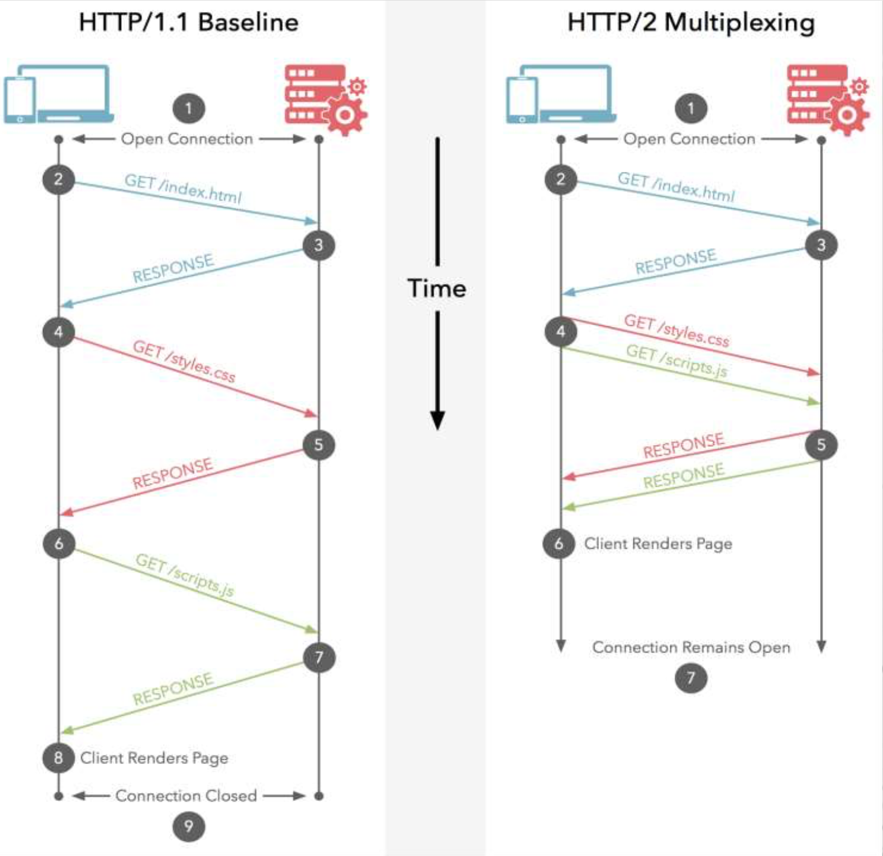
After HTTP/1.1
SPDY (speedy) and its moral successor HTTP/2
Binary protocol
Multiplexing
Interleaved

Slide 58
After HTTP/1.1
SPDY (speedy) and its moral successor HTTP/2
Binary protocol
Multiplexing
Priority control over Frames
Header Compression
Server Push
Proactively push stuff to client that it will need

Slide 59
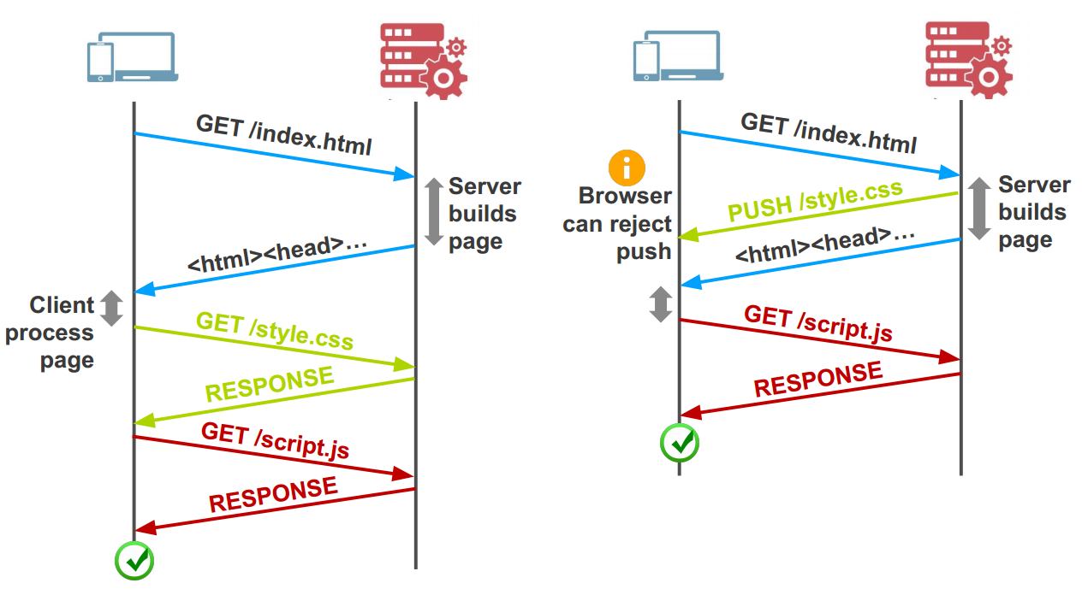
After HTTP/1.1
SPDY (speedy) and its moral successor HTTP/2
Binary protocol
Multiplexing
Priority control over Frames
Header Compression
Server Push
Proactively push stuff to client that it will need

Slide 60
After HTTP/1.1
SPDY (speedy) and its moral successor HTTP/2
Binary protocol
Multiplexing
Priority control over Frames
Header Compression
Server Push

Slide 61
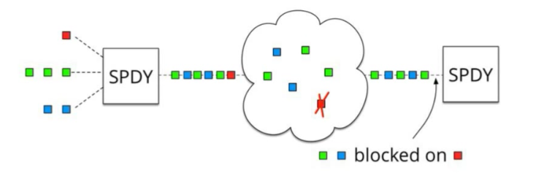
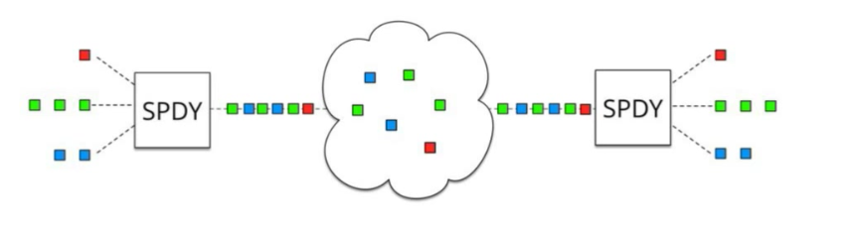
SPDY
SPDY + HTTP/2: One single TCP connection instead of multiple
Downside: Head of line blocking
In TCP, packets need to be processed in correct order

Slide 62
Add QUIC and stir… Quick UDP Internet Connections
Objective: Combine speed of UDP protocol with TCP’s reliability
Very hard to make changes to TCP
Faster to implement new protocol on top of UDP
Roll out features in TCP if they prove theory
QUIC:
Reliable transport over UDP (seriously)
Uses FEC
Default crypto
Restartable connections

Slide 63
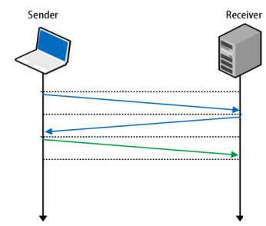
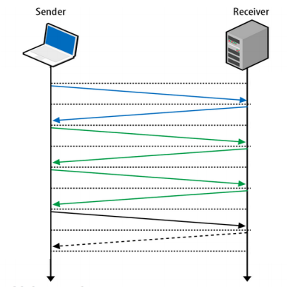

3-Way Handshake
Without TLS
With TLS

Slide 64
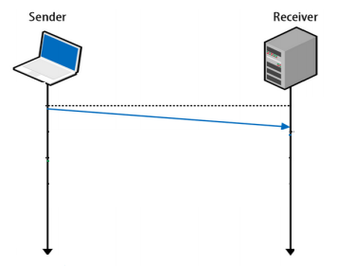
UDP
Fire and forget
Less time spent to validate packets
Downside - no reliability, this has to be built on top of UDP

Slide 65
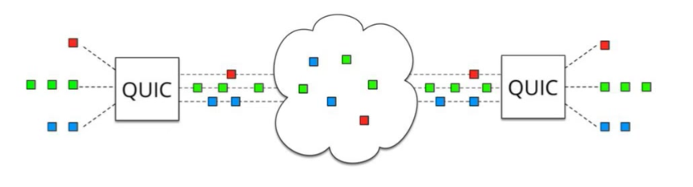
QUIC
UDP does NOT depend on order of arriving packets
Lost packets will only impact an individual resource, e.g., CSS or JS file.
QUIC is combining best parts of HTTP/2 over UDP:
Multiplexing on top of non-blocking transport protocol

Slide 66
QUIC – more than just UDP
QUIC outshines TCP under poor network conditions, shaving a full second off the Google Search page load time for the slowest 1% of connections.
These benefits are even more apparent for video services like YouTube. Users report 30% fewer rebuffers when watching videos over QUIC.

Slide 67
Why QUIC over UDP and not a new proto
IP proto value for new transport layer
Change the protocol – risk the wraith of
Legacy code
Firewalls
Load-balancer
NATs (the high-priest of middlebox)
Same problem faces any significant TCP change
Honda M. et al. “Is it still possible to extend TCP?”, IMC’11
https://dl.acm.org/doi/abs/10.1145/2068816.2068834

Slide 68
SIP – Session Initiation Protocol
Session?
Anyone smell an OSI / ISO standards document burning?

Slide 69
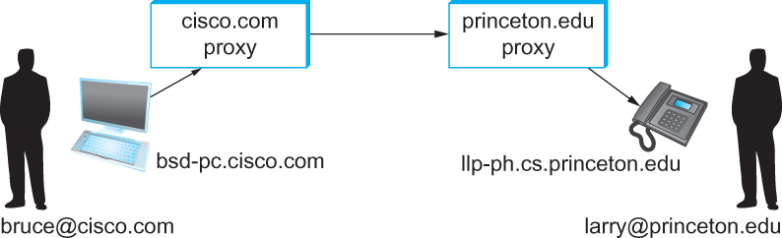

SIP - VoIP
Establishing communication through SIP proxies.

Slide 70
SIP?
SIP – bringing the fun/complexity of telephony to the Internet
User location
User availability
User capabilities
Session setup
Session management
(e.g. “call forwarding”)

Slide 71
H.323 – ITU
Why have one standard when there are at least two….
The full H.323 is hundreds of pages
The protocol is known for its complexity – an ITU hallmark
SIP is not much better
IETF grew up and became the ITU….

Slide 72
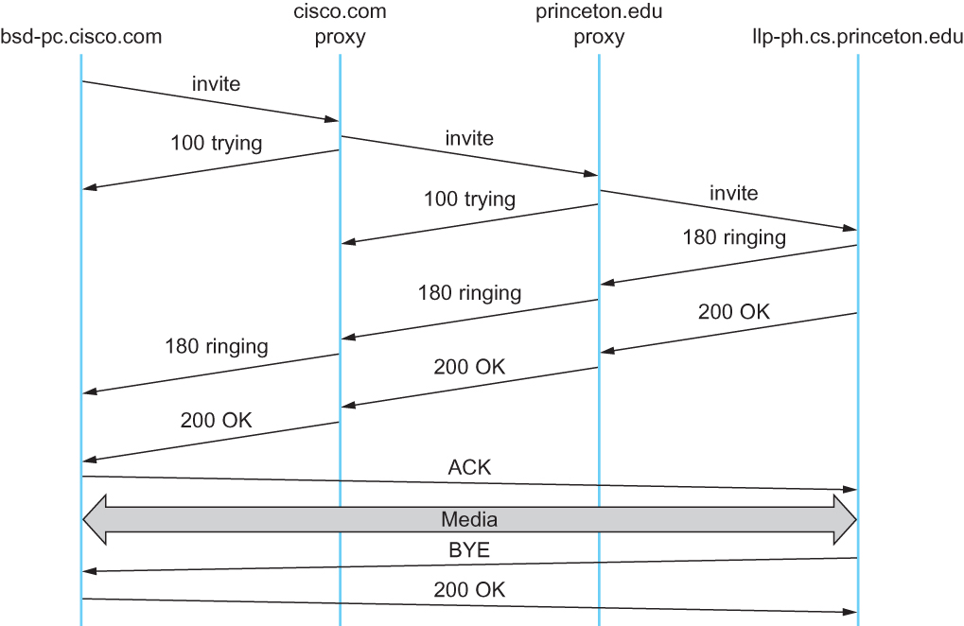
Multimedia Applications
Message flow for a basic SIP session

Slide 73
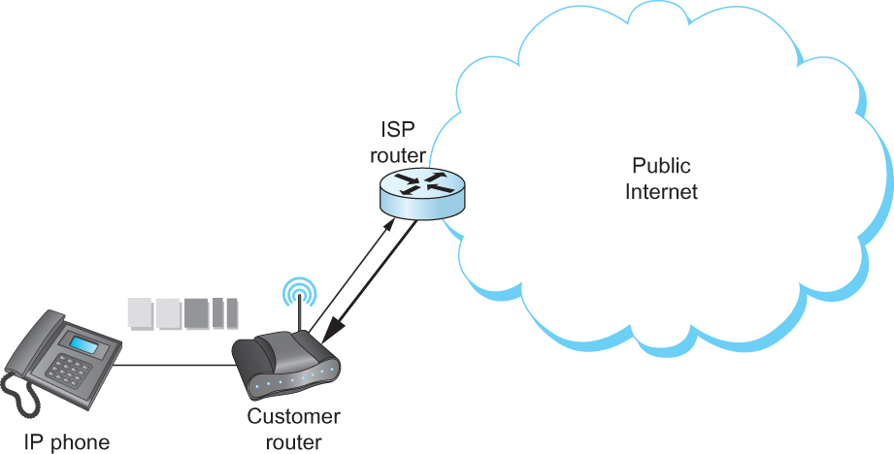
The (still?) missing piece: Resource Allocation for Multimedia Applications
I can ‘differentiate’ VoIP from data but…
I can only control data going into the Internet

Slide 74
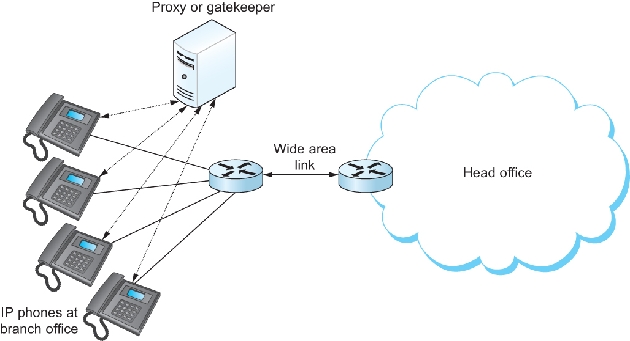
Multimedia Applications
Resource Allocation for Multimedia Applications
Admission control using session control protocol.

Slide 75
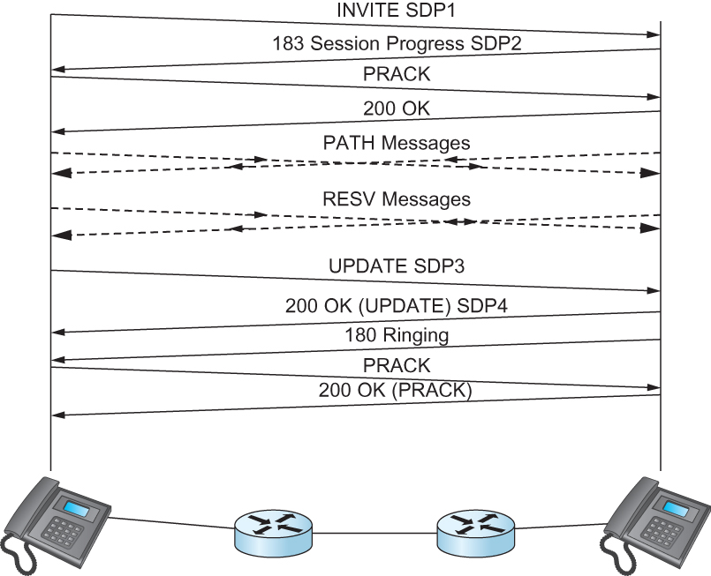
Resource Allocation for Multimedia Applications
So where does it happen?
Inside single institutions or domains of control…..
(Universities, Hospitals, big corp…)
What about my aDSL/CABLE/etc it combines voice and data?
Phone company controls the multiplexing on the line
and throughout their own network too…… everywhere else is best-effort
Coming soon… 1995
2000
2010
2020
who are we kidding??
Co-ordination of SIP signaling and
resource reservation.

Slide 76
Every host is a server: Peer-2-Peer

Slide 77
Pure P2P architecture
no always-on server
arbitrary end systems directly communicate
peers are intermittently connected and change IP addresses
Three topics:
File distribution
Searching for information
Case Study: Skype
peer-peer
Notes:
Skype hybrid, Bittorrent - pure

Slide 78
File Distribution: Server-Client vs P2P
Question : How much time to distribute file from one server to N peers?
u_{s}: server upload bandwidth
Server
u_{i}: peer i upload bandwidth
u₁
d₁
u₂
u_{s}
d₂
d_{i}: peer i download bandwidth
File, size F
d_{N}
Network (with
abundant bandwidth)
u_{N}

Slide 79
File distribution time: server-client
Server
server sequentially sends N copies:
NF/u_{s} time
client i takes F/d_{i} time to download
F
u₁
d₁
u₂
u_{s}
d₂
d_{N}
Network (with
abundant bandwidth)
u_{N}
Time to distribute F
to N clients using
client/server approach
= d_{cs} = max { NF/u_{s}, F/min(d_{i}) }
i
increases linearly in N
(for large N)

Slide 80
File distribution time: P2P
Server
server must send one copy: F/u_{s} time
client i takes F/d_{i} time to download
NF bits must be downloaded (aggregate)
F
u₁
d₁
u₂
u_{s}
d₂
d_{N}
Network (with
abundant bandwidth)
u_{N}
fastest possible upload rate: u_{s} + Σu_{i}
d_{P2P} = max { F/u_{s}, F/min(d_{i}) , NF/(u_{s} + Σu_{i}) }
i

Slide 81
Server-client vs. P2P: example
Client upload rate = u, F/u = 1 hour, u_{s} = 10u, d_{min} ≥ u_{s}
Notes:
25-frb-2015

Slide 82

File distribution: BitTorrent* *rather old BitTorrent
P2P file distribution
tracker: tracks peers
participating in torrent
torrent: group of
peers exchanging
chunks of a file
obtain list
of peers
trading
chunks
peer

Slide 83
BitTorrent (1)
file divided into 256KB chunks.
peer joining torrent:
has no chunks, but will accumulate them over time
registers with tracker to get list of peers, connects to subset of peers (“neighbors”)
while downloading, peer uploads chunks to other peers.
peers may come and go
once peer has entire file, it may (selfishly) leave or (altruistically) remain

Slide 84
BitTorrent (2)
Pulling Chunks
at any given time, different peers have different subsets of file chunks
periodically, a peer (Alice) asks each neighbor for list of chunks that they have.
Alice sends requests for her missing chunks
rarest first
Sending Chunks: tit-for-tat
Alice sends chunks to four neighbors currently sending her chunks at the highest rate
re-evaluate top 4 every 10 secs
every 30 secs: randomly select another peer, starts sending chunks
newly chosen peer may join top 4
“optimistically unchoke”

Slide 85

BitTorrent: Tit-for-tat
(1) Alice “optimistically unchokes” Bob
(2) Alice becomes one of Bob’s top-four providers; Bob reciprocates
(3) Bob becomes one of Alice’s top-four providers
With higher upload rate, can find better trading
partners & get file faster!
Notes:
GOT HERE 6/Feb/2011

Slide 86
Distributed Hash Table (DHT)
DHT = distributed P2P database
Database has (key, value) pairs;
key: ss number; value: human name
key: content type; value: IP address
Peers query DB with key
DB returns values that match the key
Peers can also insert (key, value) peers
Notes:
SKIP ME 85-91

Slide 87
Distributed Hash Table (DHT)
DHT = distributed P2P database
Database has (key, value) pairs;
key: ss number; value: human name
key: content type; value: IP address
Peers query DB with key
DB returns values that match the key
Peers can also insert (key, value) peers
Notes:
SKIP ME 85-91

Slide 88
DHT Identifiers
Assign integer identifier to each peer in range [0,2^{n}-1].
Each identifier can be represented by n bits.
Require each key to be an integer in same range.
To get integer keys, hash original key.
eg, key = h(“Game of Thrones season 29”)
This is why they call it a distributed “hash” table

Slide 89
How to assign keys to peers?
Central issue:
Assigning (key, value) pairs to peers.
Rule: assign key to the peer that has the closest ID.
Convention in lecture: closest is the immediate successor of the key.
Ex: n=4; peers: 1,3,4,5,8,10,12,14;
key = 13, then successor peer = 14
key = 15, then successor peer = 1

Slide 90
Circular DHT (1)
1
3
15
4
12
5
10
8
Each peer only aware of immediate successor and predecessor.
“Overlay network” – logical structure

Slide 91
Circle DHT (2)
O(N) messages
on avg to resolve
query, when there
are N peers
0001
Who’s resp
for key 1110 ?
I am
0011
1111
1110
1110
0100
1110
1100
1110
0101
1110
Define closest as closest successor
1110
1010
1000

Slide 92
Circular DHT with Shortcuts
1
Who’s resp
for key 1110?
3
15
4
12
5
10
8
Each peer keeps track of IP addresses of predecessor, successor, short cuts.
Reduced from 6 to 2 messages.
Possible to design shortcuts so O(log N) neighbors, O(log N) messages in query

Slide 93
Peer Churn
1
To handle peer churn, require
each peer to know the IP address
of its two successors.
Each peer periodically pings its two successors to see if they are still alive.
3
15
4
12
5
10
8
Peer 5 abruptly leaves
Peer 4 detects; makes 8 its immediate successor; asks 8 who its immediate successor is; makes 8’s immediate successor its second successor.
What if peer 13 wants to join?

Slide 94

P2P Case study: Skype (pre-Microsoft)
Skype clients (SC)
inherently P2P: pairs of users communicate.
proprietary application-layer protocol (inferred via reverse engineering)
hierarchical overlay with SNs
Index maps usernames to IP addresses; distributed over SNs
Skype
login server
Supernode
(SN)

Slide 95
Peers as relays
Problem when both Alice and Bob are behind “NATs”.
NAT prevents an outside peer from initiating a call to insider peer
Solution:
Using Alice’s and Bob’s SNs, Relay is chosen
Each peer initiates session with relay.
Peers can now communicate through NATs via relay

Slide 96
Summary.
Applications have protocols too
We covered examples from
Traditional Applications (web)
Scaling and Speeding the web (CDN/Cache tricks)
Infrastructure Services (DNS)
Cache and Hierarchy
Multimedia Applications (SIP)
Extremely hard to do better than worst-effort
P2P Network examples

Slide 97
Class of 2020/2021
I miss lectures, the feedback and the contact
Pre-recorded videos are no substitute for live or life.
These lectures were more efficient but lacked stories, lacked interaction, lacked fun, lacked chocolate…
I am sorry for this and look forward to future normality.
Thank you.

